Slide 1

CSDOL7011: Natural Language Processing - Mini Project
DM Your Data
A hybrid RAG system that lets you query tabular data in plain English, combining LLM-generated SQL with vector-based semantic search.
Name: Girish Dayaghan Sakpal
UIN: 231A011
Class: BE – AI&DS

Slide 2

One tool, stretched over two different jobs
Precise aggregation and conceptual meaning-matching are fundamentally different tasks. Most "chat with your data" demos pick one trick and stretch it too far, yielding brittle or incorrect answers when the question type doesn't match the underlying method.
Pure text-to-SQL
Pure vector search
Excellent at precise aggregation such as counts, averages, filters, sorting.
Cannot represent feelings or concepts e.g., "reviews that sound frustrated".
Breaks when the question is conceptual rather than structural.
Excellent at fuzzy, conceptual, meaning-based matching.
Cannot reliably perform arithmetic or exact aggregations like "average price by category".
Breaks when an exact number or strict filter is required.
The mismatch between semantic intent and structural computation is the core problem we solve with routing.

Slide 3
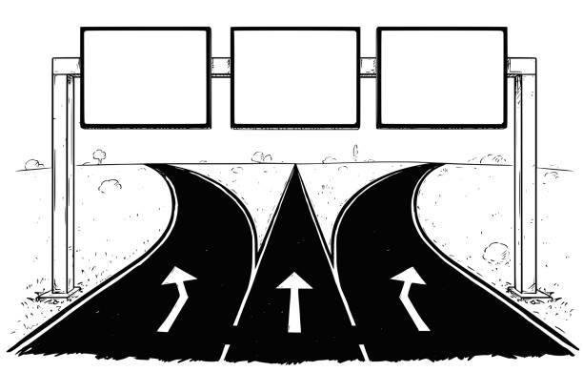
DM Your Data picks the right lane - and a third lane for when it's both
The system classifies each question into one of three modes: Structured (SQL), Semantic (vector search), or Hybrid (a deterministic mix). The classifier is visible and auditable in the UI — we show which lane was chosen and why.
SQL
Hybrid
Semantic
Structured (SQL)
Hybrid
"Average price by category" - exact aggregations executed in Postgres.
"Frustrated customers in the West region" - filter rows with SQL, re-rank by semantic similarity.
Semantic
"Reviews about slow shipping" - pgvector cosine search over embeddings.
Every demo question lights up exactly one lane in the UI for transparency and debugging.

Slide 4

Tech Stack
Web framework
Database
DB driver
Flask — small, unopinionated. Keeps complexity in the NLP pipeline.
Supabase (Postgres + pgvector) — avoids local Postgres build tools on Windows.
pg8000 — pure Python, avoids psycopg2 binary build issues on Python 3.13/Windows.
LLMs
Embeddings
qwen2.5-coder:3b for SQL generation; llama3.2:3b for routing/decomposition.
all-MiniLM-L6-v2 — 384-dim, CPU-friendly for short review text.

Slide 5
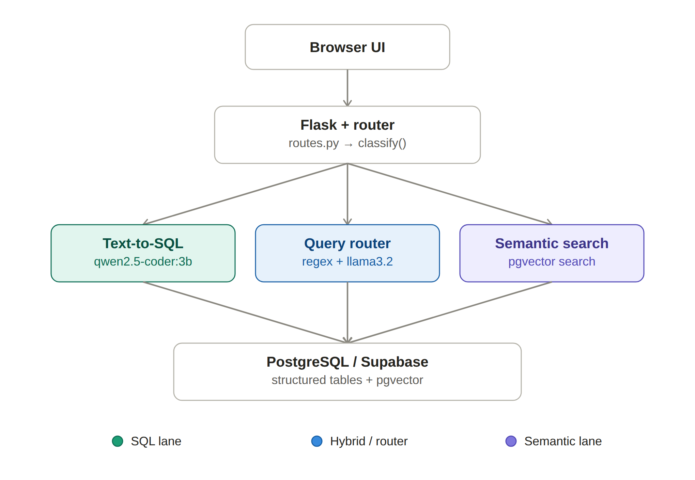

System Architecture
Browser UI
Flask Router
Parallel Paths
Combine & Return
It runs on one Flask process, one Postgres/Supabase instance, and two local models. Every LLM call goes through an Ollama wrapper, with temperature set to 0 whenever we need deterministic output.
Nothing leaves the laptop, local models, local embeddings, and a self-contained Postgres instance; no external inference APIs in the request path.

Slide 6
How each lane actually works
Question in → route → validated output. Three coordinated mechanisms share a common safety layer and registry.
Text-to-SQL
Query router & Semantic search
Prompt includes schema, sample rows, and cached profiling notes.
qwen2.5-coder:3b generates SELECT-only statements; forbidden keywords are rejected.
Auto-LIMIT 500; one retry loop sends error back into the model for correction.
Heuristic regex first; llama3.2:3b fallback for ambiguous cases.
If dataset lacks a text column, force the SQL lane.
Embeddings cached on load; pgvector cosine search with 0.8 cutoff to drop weak matches.
Hybrid mode: decomposition produces a SQL filter (validated) to get candidate IDs, then semantic re-ranking runs only on that subset for precision and efficiency.

Slide 7
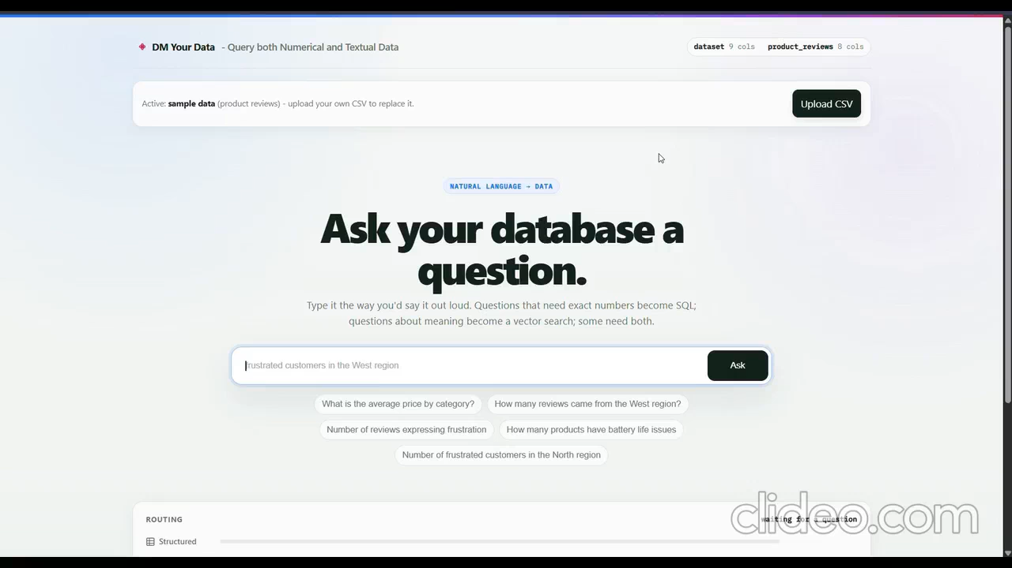
How DM Your Data worked on a Numerical Dataset:

Slide 8
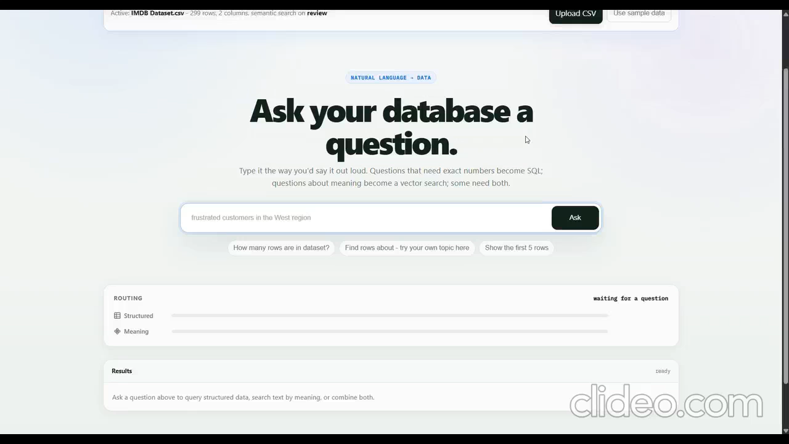
How DM Your Data worked on a Textual Dataset:

Slide 9

Supporting systems: profiling and CSV upload
Profiling & outlier detection
CSV upload pipeline
Per-column stats (nulls, cardinality, min/max/mean/stddev) cached in profile_report.json.
Stats fold directly into SQL prompts (e.g., "region: 4 distinct values") to steer exact-match filters.
Outliers detected by z-score (>3σ) and IQR (Tukey's fence), computed in SQL for scale.
Parse and validate (caps: 5MB / 5,000 rows), sanitize and infer types, then replace active dataset.
Text column auto-detected when average string length > 25 characters.
First 1,000 rows are embedded; a central registry exposes table/column names to all downstream modules.
Design decision: embedding only a subset (1k rows) keeps latency bounded and enables quick iteration during demos.

Slide 10
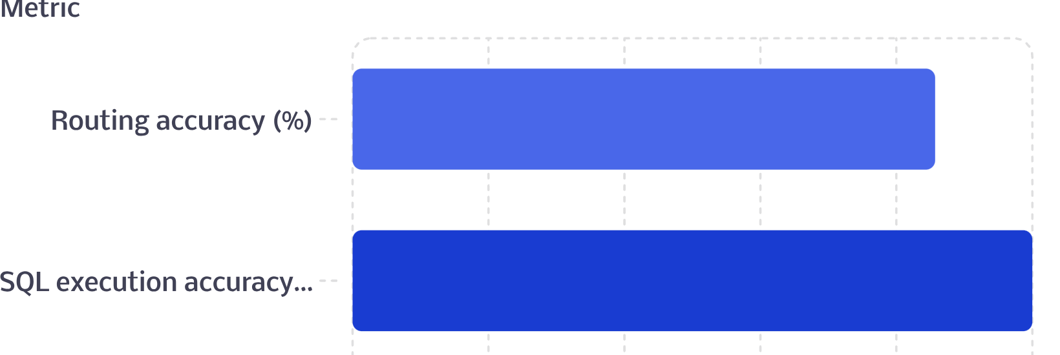
Evaluation harness
85.7%
100%
Evaluation details: 14 hand-labelled cases. SQL execution accuracy compares generated SQL against a reference by executing both and comparing result sets (order- and column-order-independent). Semantic and hybrid evaluations use standard IR metrics (precision@k, recall) against labelled relevant row IDs. Every run is timestamped and appended to a history CSV for longitudinal tracking.

Slide 11
Known limitations and what's next
Known limitations
Future work
Upload caps: CSVs limited to 5MB / 5,000 rows; only the first 1,000 rows get embedded even on larger files
Query result caps: SQL responses auto-limited to 500 rows, semantic search considers only the top 10 nearest matches
Create a labeled eval corpus independent of the seed schema so evaluations survive dataset swaps.
Trigger automatic profiling on every ingestion and expose NL controls to re-run it.
Integrate profiling/outlier views into the UI (not raw JSON).
Add a manual override for auto-detected text columns and improve routing explanations for edge cases.

Slide 12
Conclusion
DM Your Data addresses a practical unanswered question: let users ask plain-English questions over tabular data and return the appropriate kind of answer - sometimes a precise number, sometimes conceptually relevant rows. Instead of forcing one technique to do both, the system routes each query to Structured SQL, Semantic search, or a Hybrid flow and makes that routing visible and auditable.
DM Your Data Github Repository
What I built
Key results
Next steps
Schema-aware text-to-SQL with validation, pgvector semantic search, a two-tier router, profiling/outlier detection, and a CSV pipeline for rapid dataset swaps.
100% execution accuracy on labelled SQL cases; 85.7% routing accuracy across lanes.
Independent eval set, automatic profiling on ingestion, NL routing into profiling/outliers, and manual column overrides.
Thank You!

